Slide 1
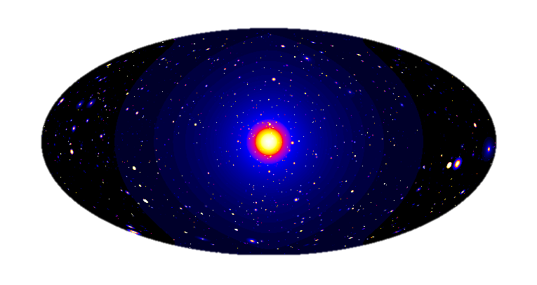
Hands-on session: How to search for Dark Matter with CTA?
Judit Pérez-Romero & Gabrijela Zaharijas
Cosmology and Astrophysics Center
University of Nova Gorica
judit.perez@ung.si

Slide 2
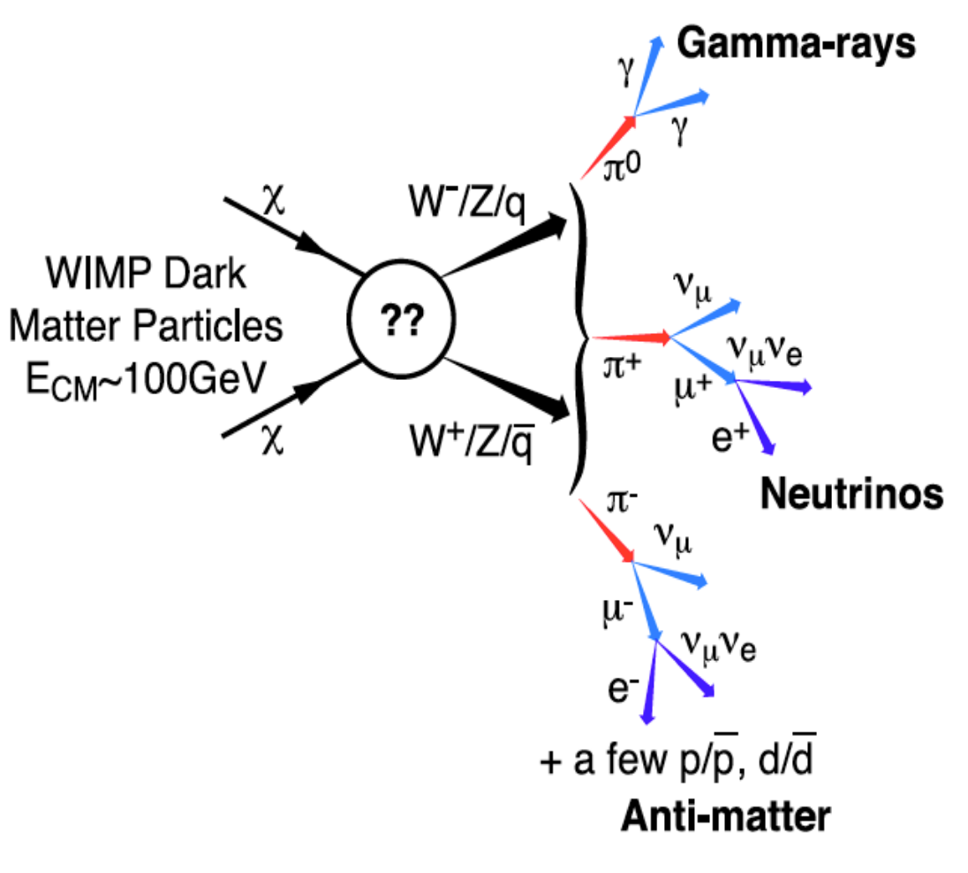
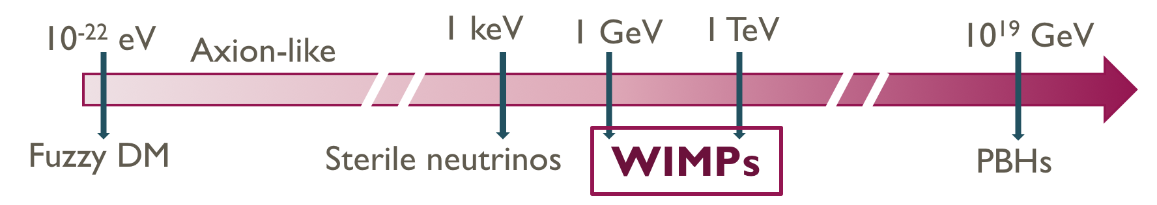
Dark matter through gamma-rays
Different DM candidates:
Component of
This 𝜸-ray emission allows to perform Indirect DM Searches with current telescopes
DM distribution in the Universe
ΛCDM Cosmology
Which are the optimal targets?
High DM density (𝜙_{DM} ∝ 𝜌_{DM}² for annihilation, 𝜙_{DM} ∝ 𝜌_{DM} for decay)
Massive nearby objects (𝜙_{DM} ∝ M/d_{Earth}²)
Low astrophysical background
Galactic Centre
Dwarf satellites
(dSphs)
Galaxy clusters
Pieri+09

Slide 3
The cherenkov telescope array observatory
Preliminary Performance Capabilities
https://www.cta-observatory.org/
Sensitivity
Angular resolution
CTA has superb capabilities for DM gamma-ray searches

Slide 4
Searching for dm with cta
Create a simulated observation of the galactic centre with DM signal
Analyze datasets provided
Analyze first dataset
Analyze second dataset

Slide 5
Searching for dm with cta
Create a simulated observation of the galactic centre with DM signal
Analyze datasets provided
Analyze first dataset
Analyze second dataset

Slide 6
Simulating cta DM observation
Basic input information to create ANY simulated data:
Livetime
Pointing
Region of Interest (ROI)
Energy range and/or binning
Instrument Response Functions (IRFs)
Model
Background model: from IRFs
Source model: can comprehend several sources, each of them has
Spectral model
Spatial model
Time model

Slide 7
Simulating cta DM observation
Basic input information to create OUR simulated data:
Livetime: 520 h
Pointing: galactic centre
Region of Interest (ROI): 20 deg x 20 deg
Energy range and/or binning: 10 bins from 20 GeV to 150 TeV
Instrument Response Functions (IRFs): Prod5-South-20deg-AverageAz-14MSTs37SSTs.180000s
Model

Slide 8
Simulating cta DM observation
Basic input information to create OUR simulated data:
Livetime: 520 h
Pointing: galactic centre
Region of Interest (ROI): 20 deg x 20 deg
Energy range and/or binning: 10 bins from 20 GeV to 150 TeV
Instrument Response Functions (IRFs): Prod5-South-20deg-AverageAz-14MSTs37SSTs.180000s
Model
Background model: from IRFs
Source model: only one DM source
Spectral model: WIMP annihilation
Spatial model: Template emission model for the galactic centre
Time model

Slide 9

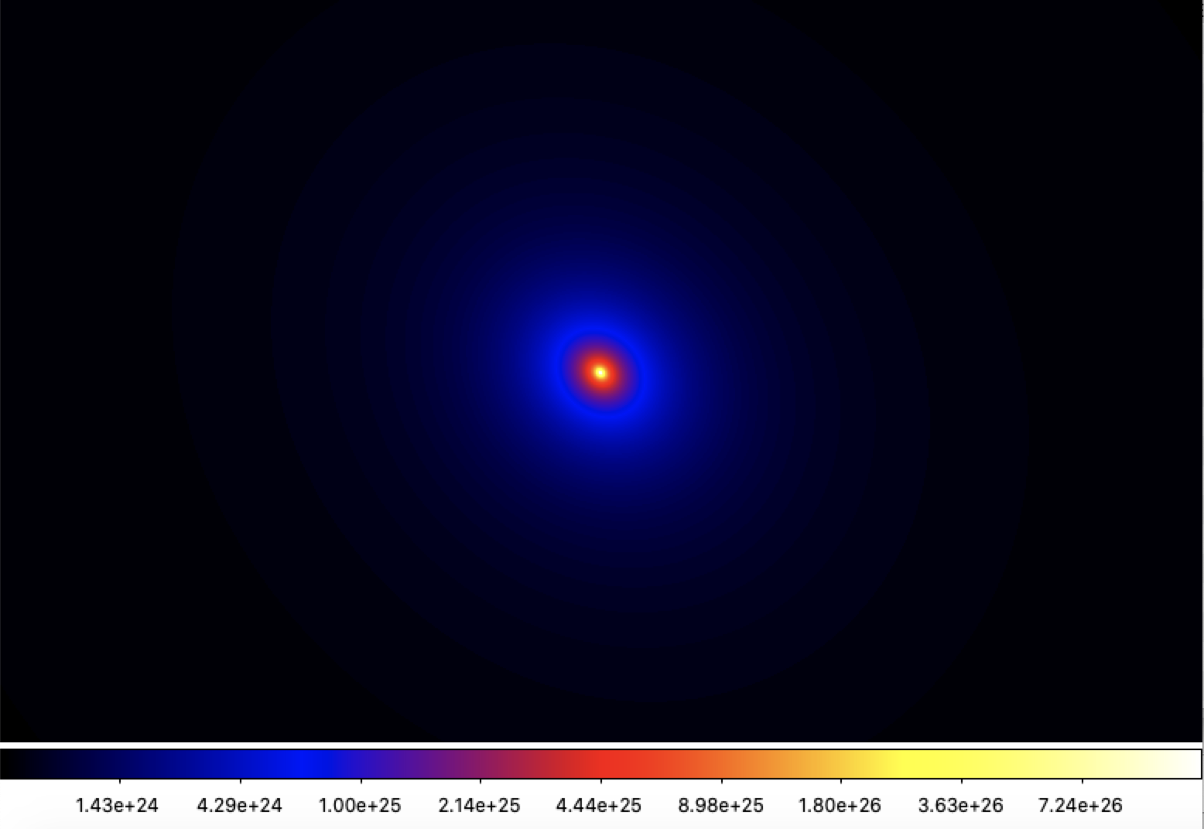

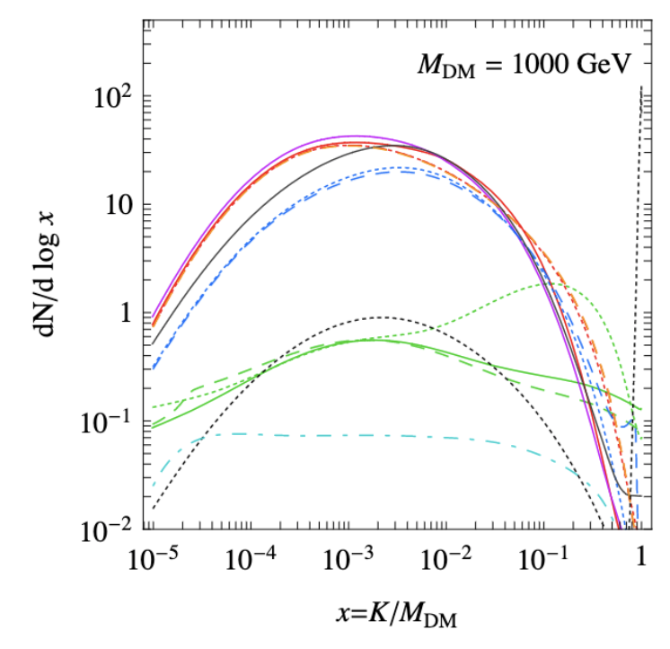
Simulating cta DM observation
Basic input information to create OUR simulated data:
Model
Spectral model
Spatial model
[Cirelli+11]
Gamma-ray emission spectrum from:
WIMP annihilation
m_{DM} = 5 TeV
bƃ channel
Created with CLUMPY software
[Charbonnier+12, Bonnivard+15, Hütten+18]
https://clumpy.gitlab.io/CLUMPY/

Slide 10
Searching for dm with cta
Create a simulated observation of the galactic centre with DM signal
Analyze datasets provided
Analyze first dataset
Analyze second dataset

Slide 11
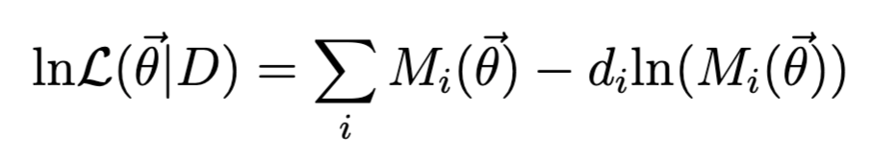
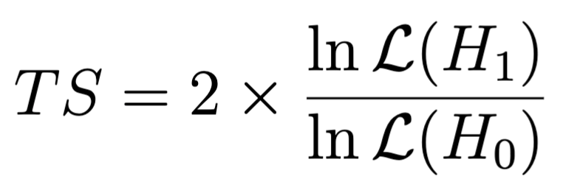
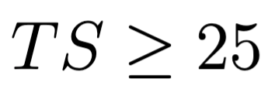
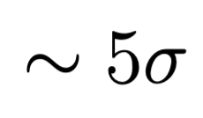
Analyze cta data searching for dm
Use maximum likelihood approach with a 3D fitting: 2 dimensions in space and 1 in energy
Cash statistics [Cash 79]
To test if a model is better than other to fit a dataset we use the likelihood ratio test (TS):
If H₀ is the null-hypothesis (only background), we determine a detection when
detection

Slide 12
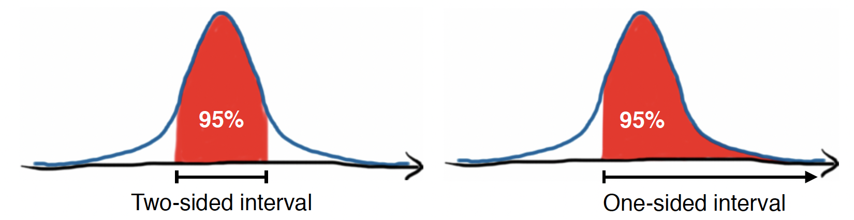
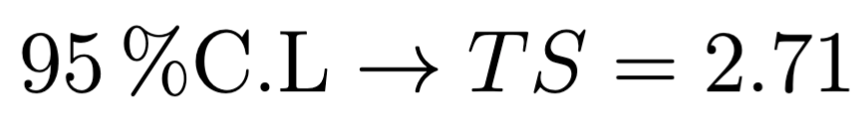
Analyze cta data searching for dm
We have not found a signal… Then let’s put constraints!
The limits can be one sided or two sided
[picture by S. Fegan for Fermi-LAT school]
This limits read as: the upper/lower value most probable to get by 95% of the times (if TS is distributed following a 𝜒²)
For the one-sided distribution
[Rolke+05]

